Slide 1


Westlake Beamer Presentation Theme
Using L^{A}T_{E}X to prepare slides
ZX
School of Engineering June 24, 2025

Slide 2

Contents
Introduction
Examples
Summary

Slide 3
Slide-Making in L^{A}T_{E}X
PPT格式下，下面的进度条应该是不会变化的。不过PPT是有内置的。
其他一些超链接也失效了，需要手动添加。
会latex的还是latex方便很多，尤其是公式多的情况，当然图片多的情况下还是ppt方便。
如果图片很多，我会在ppt某一页里面把图片位置都放好，然后导出当前slide为图片上传到latex。或者latex上写公式截图到ppt。大家灵活选择，效率第一。

Slide 4
Beamer vs. MS PowerPoint
Compared to Microsoft PowerPoint, L^{A}T_{E}X and Beamer provides these advantages:
Beamer produces a .pdf file with no problems on fonts, formulas, or program versions.
Math typesetting in L^{A}T_{E}X is much easier, e.g.,

Slide 5
Contents
Introduction
Examples
Summary

Slide 6

Document Class
To begin with, just use beamer document class with poly theme. It should be noted that the poly.sty file should be included in the same directory as the main.tex file.
Preamble about the document class
1
\ documentclass [10 pt , aspectratio = 169 ]{ beamer }
\ usepackage { poly }
2
You can change the aspectratio to 43 to adjust the slide aspect ratio to 4:3.

Slide 7

Metadata
You can change the metadata displayed on the title slide:
Metadata
1
2
\ title { Your Title }
\ subtitle { Your Subtitle }
\ author { First Author , Second Author }
\ institute [ COMP ]{ Department of Computing }
\ date { Date }
3
4
5
Once settled, you can render the title slide with the command \maketitle in the body.

Slide 8
Texts
In a Sequence
A typical slide has bulleted points.

Slide 9
Texts
In a Sequence
A typical slide has bulleted points.
These can be uncovered in sequence.

Slide 10
Texts
In a Sequence
A typical slide has bulleted points.
These can be uncovered in sequence.
When rendered, they will be separated into multiple slides.

Slide 11
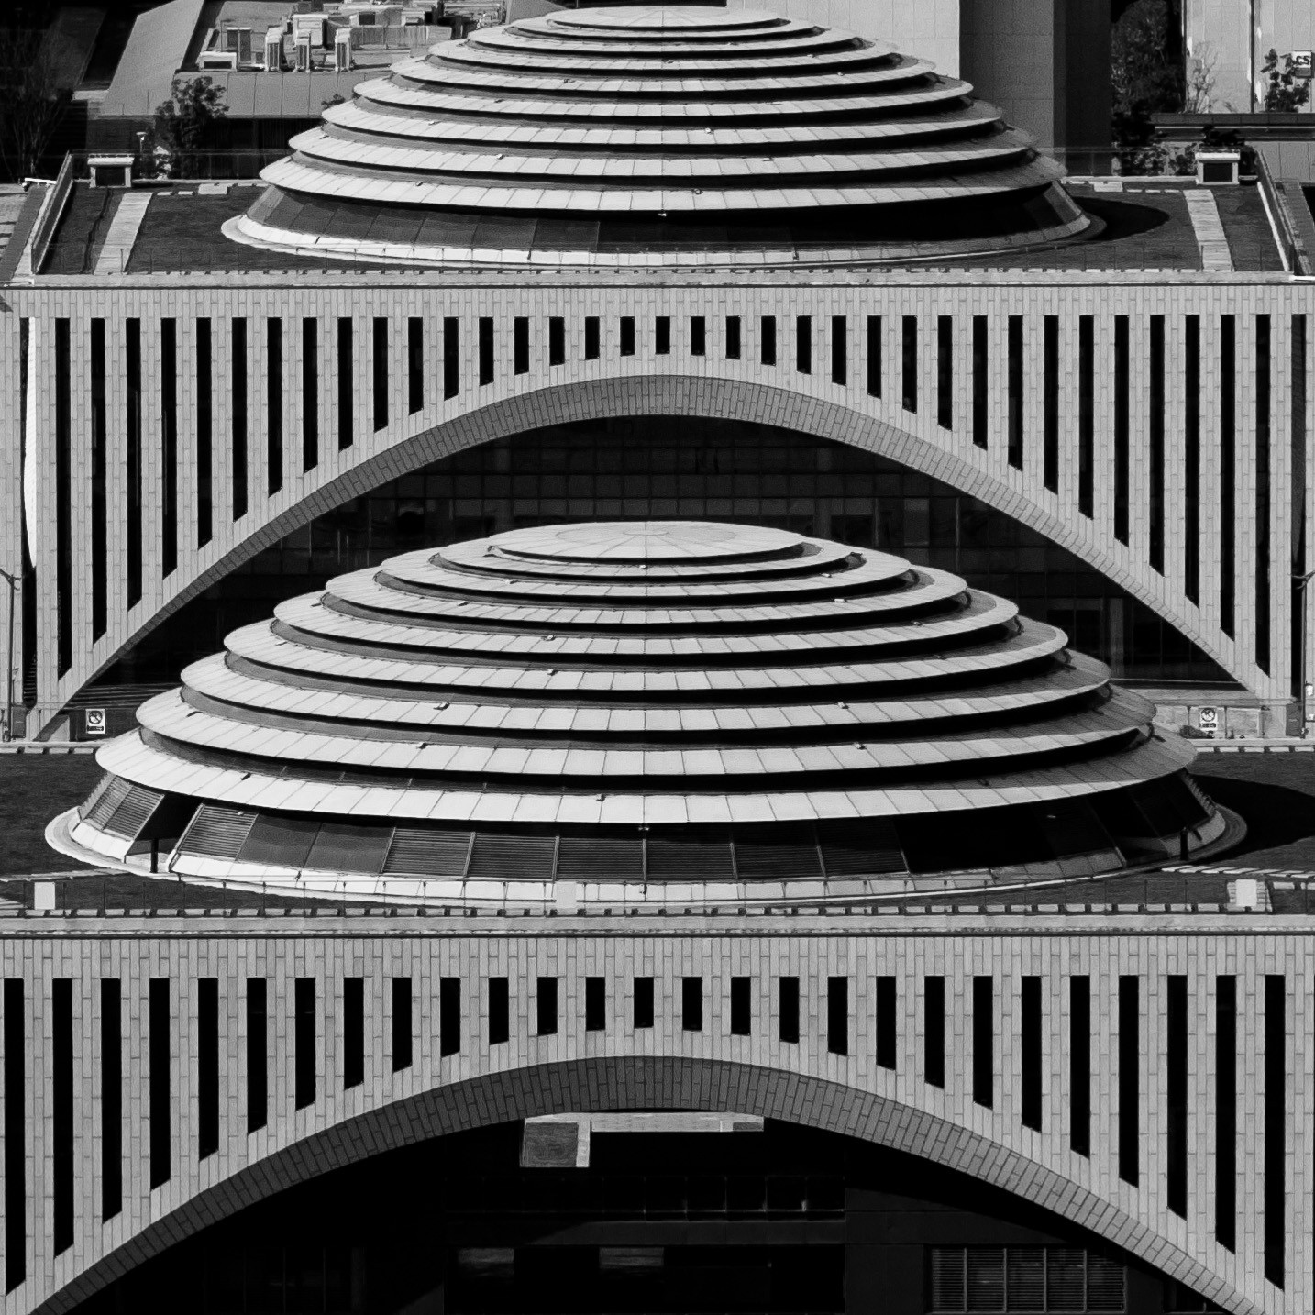
Images
Adding images works like in normal L^{A}T_{E}X:
Figure: A sample of image

Slide 12
Columns
Splitting the page is easy and common.
Typically, one side has a picture and the other text:
And this is the second one.
This is the first column.
You can have some pictures or tables here.
You can have some texts here.

Slide 13
Codes
建议latex写好截图过来
1 def | fibonacci ( n):
2 | if n == 0:
3 | return 0
4 | elif n == 1:
5 | return 1
6 | a, b = 0 , 1
7 | for _ in range (2 , | n + 1):
8 | a, b = b, a + | b
9
return b

Slide 14
Fonts
The priority when choosing a font is readability. Here, we give some advice:
Use serif (default) fonts only with high-resolution projectors or monitors.
Use sans-serif fonts otherwise.
Use italic or bold fonts to emphasize or highlight points.
We also provide an alert font for emphasise.
Use monospace fonts to display codes.

Slide 15
Contents
Introduction
Examples
Summary

Slide 16
Good Luck!
Enough for an introduction! You should know enough by now.
If you have corrections or suggestions, please feel free to contact me!
You can also find this project on Github! Stars are welcome!

Slide 17



